Slide 1

Chris Lee - Colter Decker - Matthew Brun - Ari Vilker

Slide 2

challenge
Using an iterative agglomerative clustering algorithm to group similar agencies and match to vendors

Slide 3
AGGLOMERATIVE ALGORITHM
AGENCIES
VENDORS

Slide 4
SAMPLE AGENCY CLUSTERS AND SAMPLE VENDOR CATEGORY CLUSTERS
Board of Real Property Assessment & Appeals
Contract Appeals Board
Office of Employee Appeals Public Employee Relations Board
DC Sentencing Committee
Deputy Mayor for Public Safety & Justice
Department of Education
Judicial Nomination Commission
Office of Campaign Finance
Office of Finance & Resource Management
Office of Veteran Affairs
Office of Victim Services
Advisory Neighborhood Commission
Office of Community Affairs
Automotive Service Shops
Direct Marketing Catalog Merchants
Glass, Paint, and Wallpaper Stores
Nondurable Goods
Repair Shops and Related Services
Miscellaneous Hardware Equipment
Industrial Supplies
Plumbing and Heating Equipment
Construction Materials
Computer Maintenance & Repair Service
Legal Services
Temporary Help Services
Employment Agencies
Accounting and Auditing Services
Stenographic Support Services
Holiday Inns
Lodging Hotels Motels Resorts

Slide 5
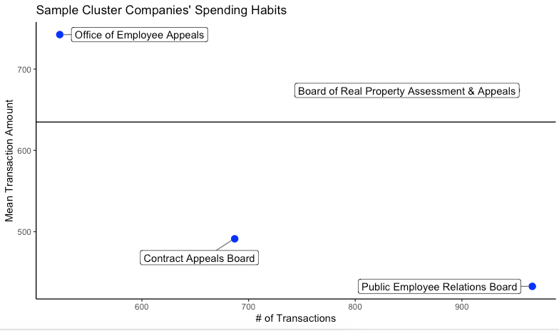
ANALYSIS OF CLUSTER 1

Slide 6
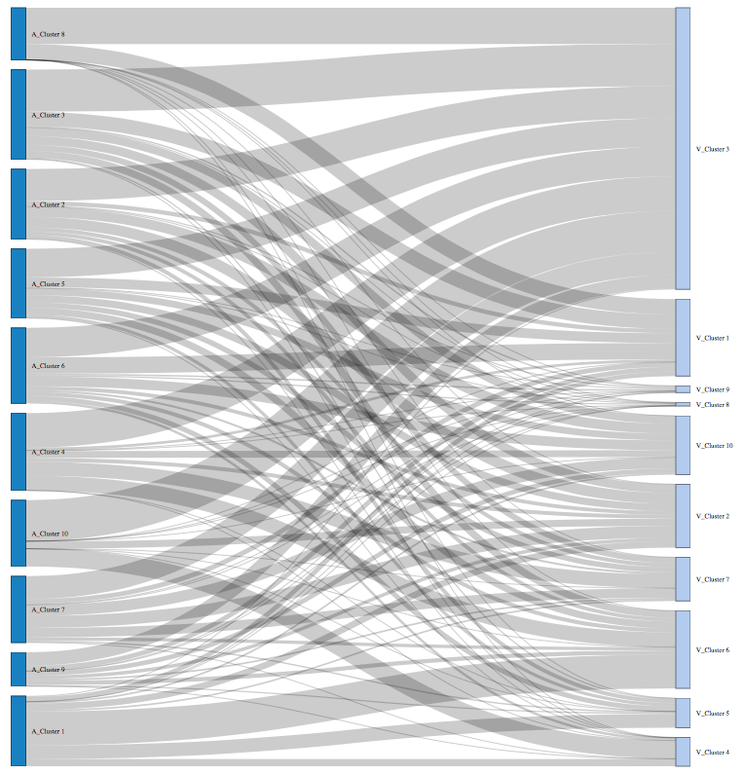
SANKEY VISUALIZATION

Slide 7
SAMPLE INDIVIDUAL VENDOR CLUSTERS
A&H Locksmith
AACCA
Academic Cap & Gown
ACT ELearningCenter
ACT Unbounded Learning
ACTE Online
ACTEX Mad River Books
ADA Appliances
5NapkinBurger
7-Eleven
8th Ave. BBQ
8th Street Grill
AAA Mid-Atlantic Region
2co.com
355 Toyota-Service
4 Wheel Drive
A 1 Drive Shaft East
Aero Industries

Slide 8
Colter Decker - Matthew Brun - Chris Lee - Ari Vilker

